Slide 1
Zybo “Audio Recorder”
Christopher Gutierrez
Cecs 561 // hardware/software codesign // spring 2019

Slide 2
Introduction/Project Vision
Initial plan/functionality for the system
Load music files (mp3, wav, etc) from microSD card to main memory
Enable switches to each play a different sound
Multiple switches enabled = sounds play on top of each other and create a “beat”
Press push button 1 to record from Mic in
Press push button 2 to playback (after all switches disabled)
Press push button 0 to store in microSD card
Plan changed! More ahead…

Slide 3
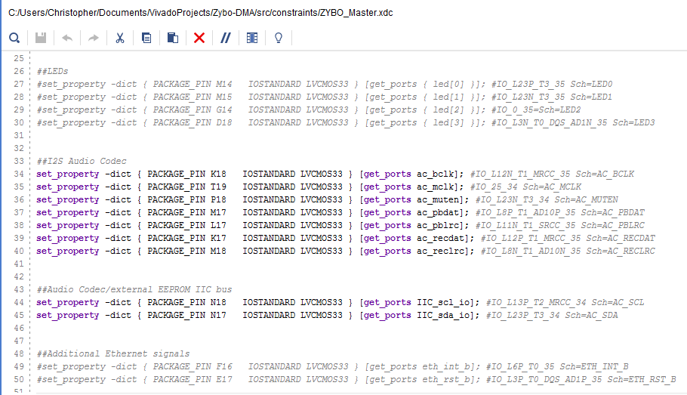
Challenges
Get the demo working
Upgrade IPs
Error running synthesis/generating bitstream
Issue where compiler wasn’t correctly locating BSP files
Fixed by typing the entire file path where necessary
Temporary Fix, need to look into where the files are located and move them around

Slide 4
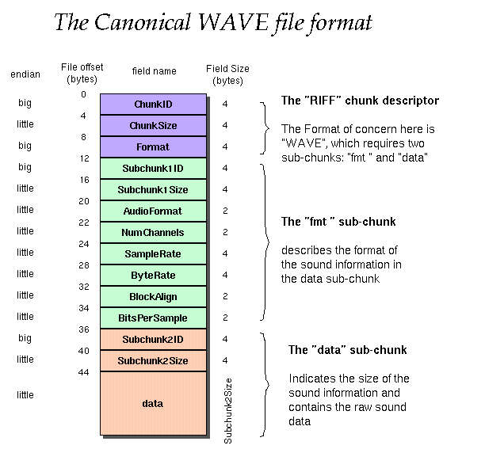
More challenges
Figuring out how the demo drivers work (more or less)
Little to no documentation
(A little) More on how it works later..
Every audio format (mp3, wav, aac) has different headers, sampling rates, etc.
How to parse file such that the codec & accompanying drivers will interpret the data correctly? (Still don’t know)
Some formats are fairly complicated (left channel samples, right channel samples, etc).. More research needed

Slide 5
Current State
Same features as demo, with the following addition:
Switches IP added to the design
Each switch combination allows a different sound to be recorded & played back
Total of 16 different 5 second tracks (woah)
Tracks are automatically stored into the microSD card

Slide 6

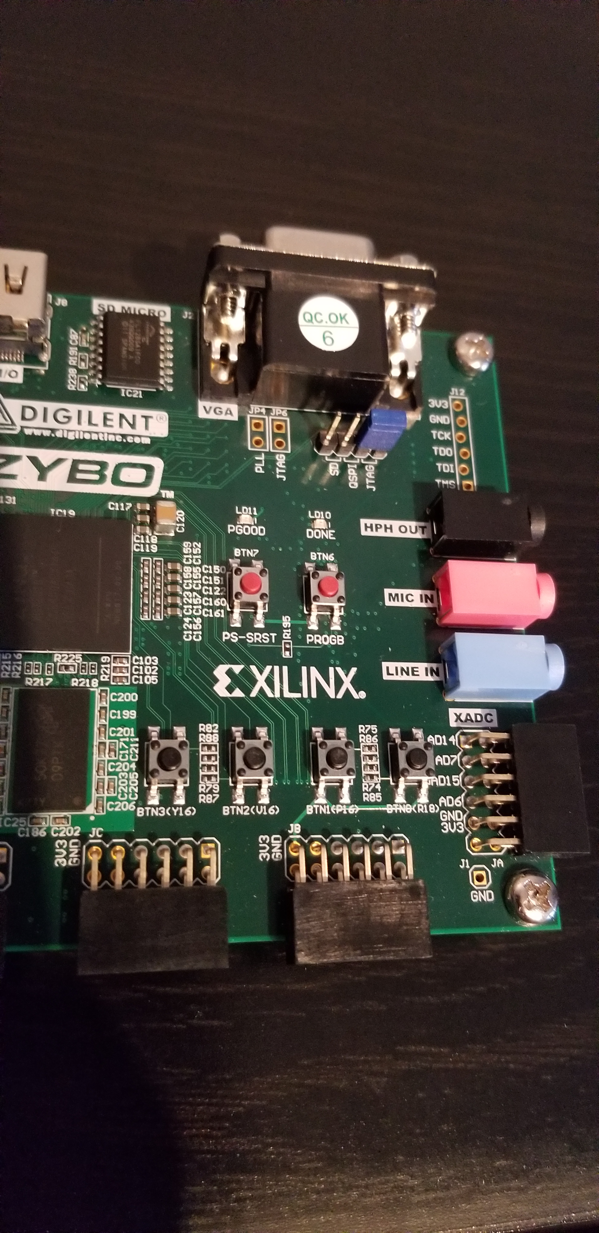
Hardware Design
IPs used (that we have already used in class)
Push buttons (AXI GPIO)
Dip switches (AXI GPIO)
UART
512 MB DDR3 Memory
New IPs
Audio codec w/ 3.5 mm jacks
Zybo board has a Line In jack, Mic In jack, and HPH Out jack
Micro SD card connector

Slide 7
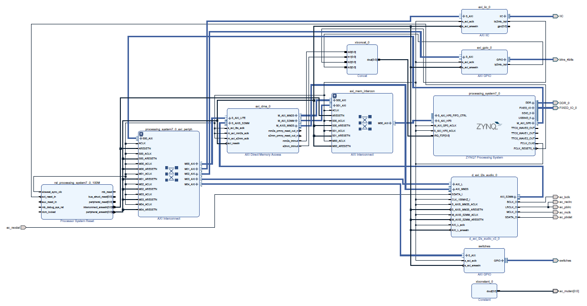
Hardware Design – Block Diagram

Slide 8
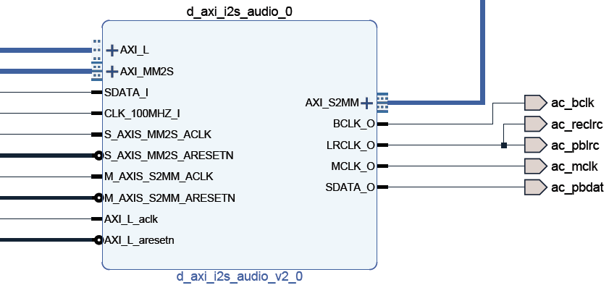
Hardware Design - d_axi_i2s_audio_0 IP Block
AXI_S2MM: Stream to Memory-mapped, transports data stream to DDR Memory
AXI_L: AXI interconnect signals
AXI_MM2S: Memory-mapped to stream, transports data from DDR memory to Audio Codec on PL

Slide 9

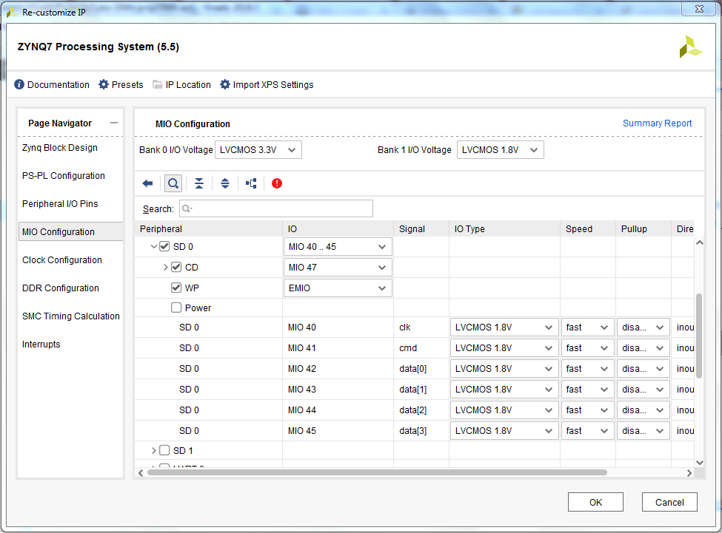



Hardware Design – Enabling microSD
Enabled by default
Some tutorials included more complicated configurations, not necessary for my project
Must enable “xilffs” in BSP Settings in SDK (Xilinx Fat File System)

Slide 10
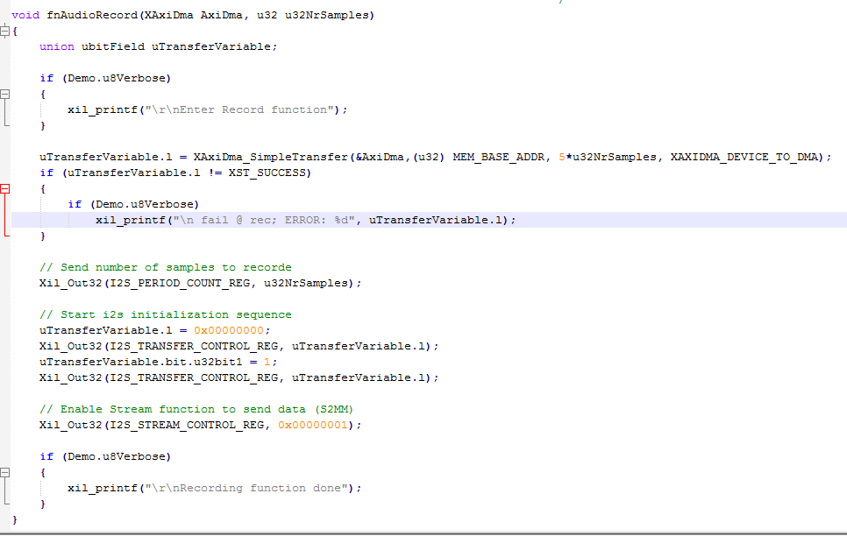
Software Design
Function in “audio.c” used in the main loop to initiate the recording process (configures controller to receive data)
AxiDma: Driver API for the AXI DMA engine
u32NrSamples: Number of samples to record/playback
MEM_BASE_ADDR: DDR Base Address
fnAudioPlay function is very similar

Slide 11
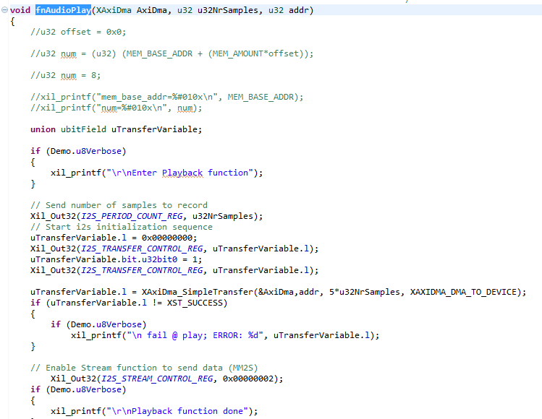
Software Design Modifications
Function in “audio.c” used in the main loop to initiate the playback process
While playing with different values for “MEM_BASE_ADDR”, realized I can dynamically allocate memory for “recordings” and pass the address to the record and play functions

Slide 12
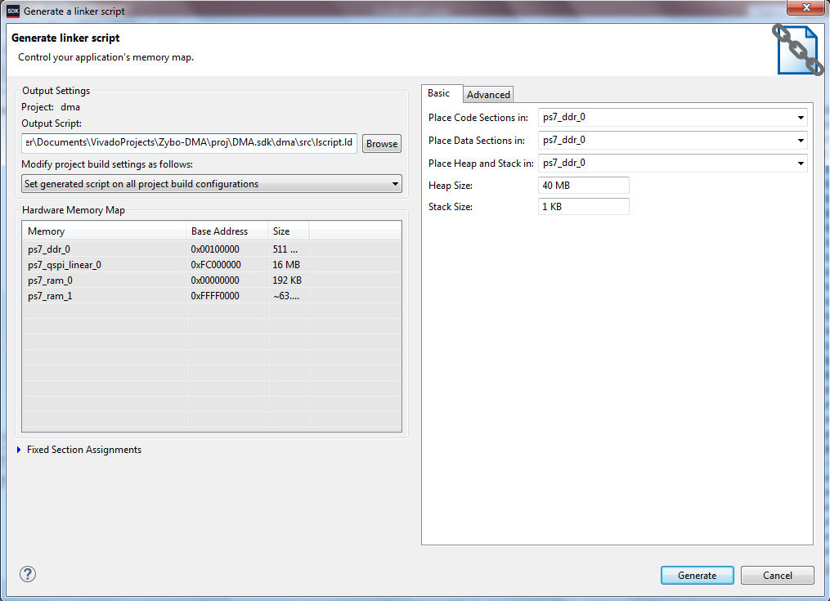
Software Mods Cont..
Add more memory to heap
Previous Heap size was 1 KB, 40 MB is plenty
Each “track” is 1-2 MB, assuming they’re 2 MB, 2*16 = 32 MB, meaning plenty of memory

Slide 13
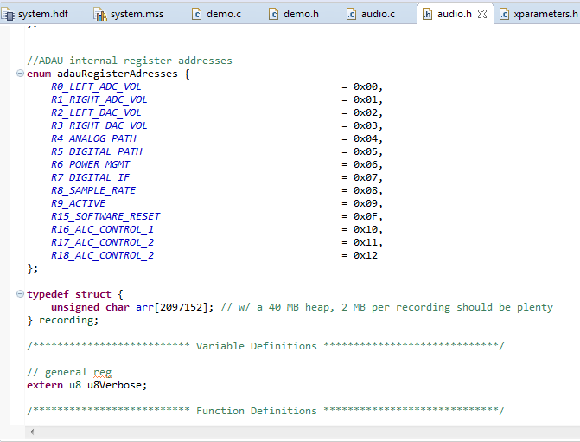
SW Design Mods Cont..
Created a struct w/ a size of 2 MB so I could use the stdlib to dynamically allocate space for each recording

Slide 14
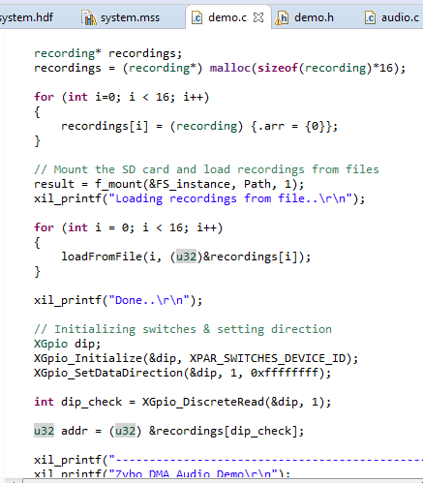
More SW Stuff..
Allocating space in memory for the recordings (16 of them)
Mounting the SD card
Load recordings from file
“loadFromFile” function explained later..

Slide 15
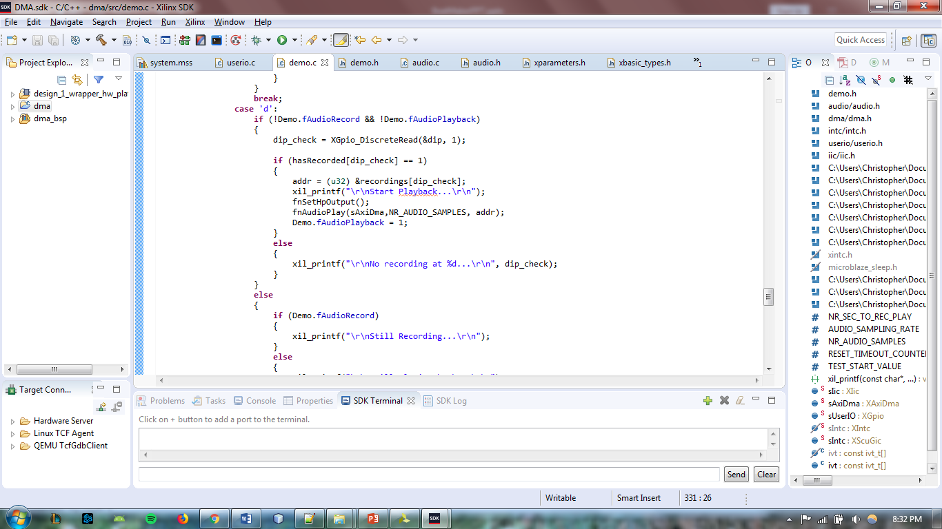
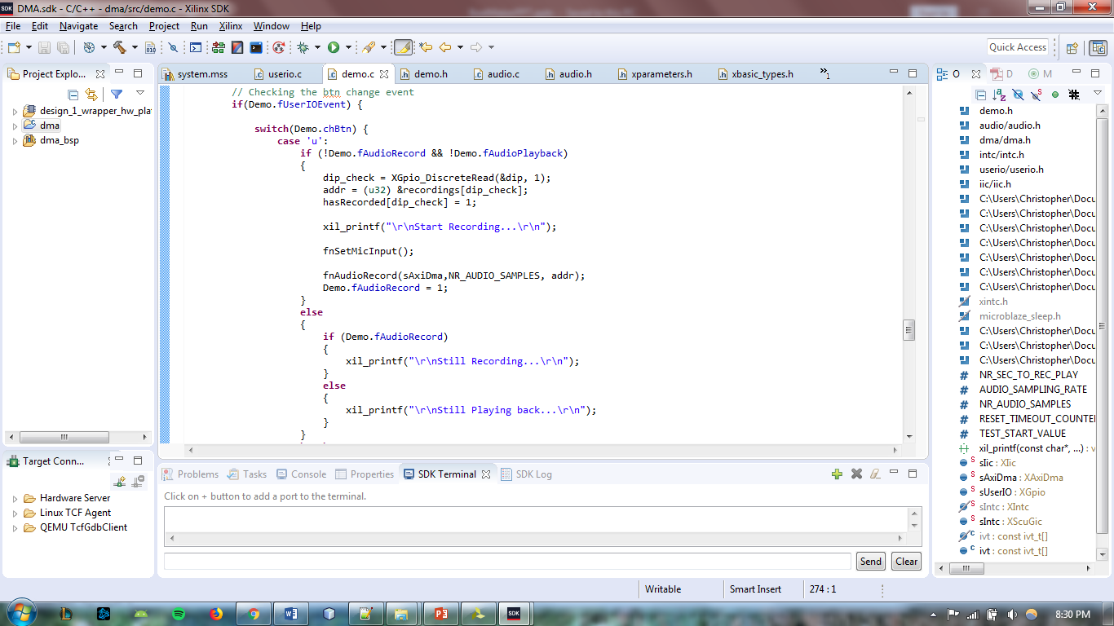
SW Modifications to “demo.c”
Snippets of code inside of main
Shows logic behind the what happens when you select a “track” and play it back
Shows logic behind the what happens when you select a “track” and record over it

Slide 16
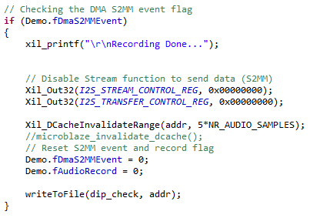
When recording is complete..

Slide 17
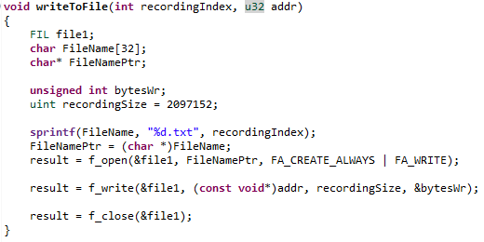
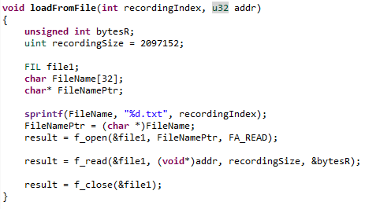
Additional Functions
writeToFile – Takes a recording from memory and stuffs it into a file
loadFromFile – Takes a recording from a file and stuffs it into memory

Slide 18
Future Work
If I somehow gain access to a board and Vivado again..
Figure out how to parse Wave files to work with demo codec/drivers
Add ability to play sounds on top of each other & record back to SD card

Slide 19
References/Resources
Digilent Resources:
https://reference.digilentinc.com/learn/programmable-logic/tutorials/zybo-dma-audio-demo/start
https://reference.digilentinc.com/learn/programmable-logic/tutorials/github-demos/start
Various Forums, Blogs, etc:
https://forum.digilentinc.com/topic/4505-zybo-dma-audio-demo-error/#comment-17914
https://forum.digilentinc.com/topic/4599-locked-ips-place_design-error-in-vivado-with-zybo-dma-audio-demo/
https://forums.xilinx.com/t5/UltraScale-Architecture/XAxiDma-SimpleTransfer-and-Maximum-Transfer-Length/td-p/780556
https://forums.xilinx.com/t5/Design-Entry/Vivado-2017-3-IP-Upgrade/td-p/813578
https://forum.digilentinc.com/topic/9224-c-code-to-readwrite-to-ddr/
https://forum.digilentinc.com/topic/1017-how-to-use-the-ddr-on-zybo/
http://www.harald-rosenfeldt.de/2017/12/31/zynq-read-a-wav-file-from-sd-card-and-play-it-on-the-audio-codec/
https://forums.xilinx.com/t5/Evaluation-Boards/Output-an-mp3-file-in-memory-card-to-audio-out-port-of-Zedboard/td-p/809606
https://lauri.xn--vsandi-pxa.com/hdl/zynq/xilinx-dma.html
C-Programming Resources:
https://www.cs.swarthmore.edu/~newhall/unixhelp/C_arrays.html#dynamic
https://www.programiz.com/c-programming/c-dynamic-memory-allocation

Slide 20
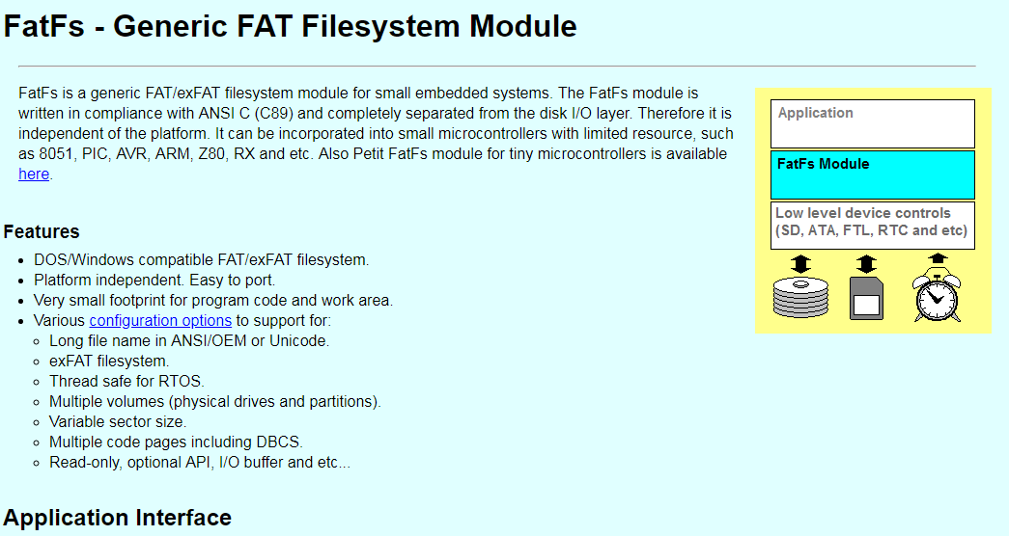
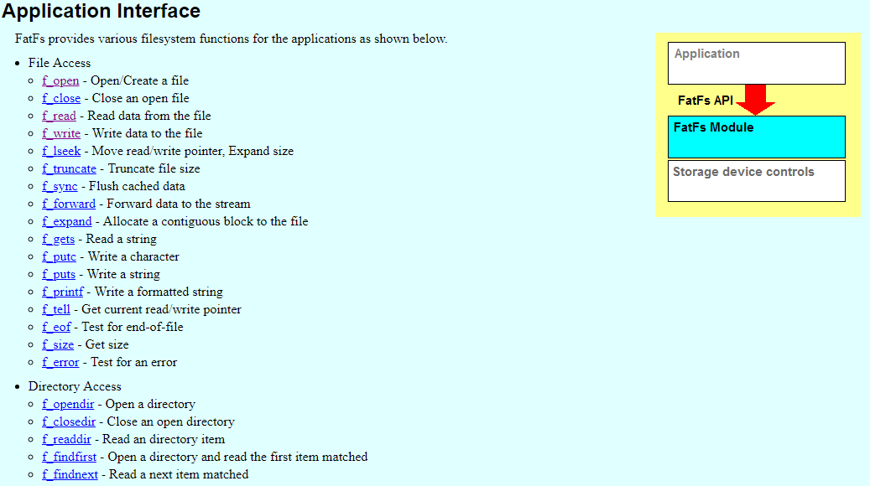
One more resource..
http://elm-chan.org/fsw/ff/00index_e.html?_ga=2.166515710.1152884192.1556995060-1875058106.1548301546

Slide 21
Fin
Thanks.

